Slide 1
Chapter 4
Operators in python

Slide 2
List of contents
Operator
Arithmetic operators
Using python interpreter as calculator
Assignment operators
Unary minus operator
Relational operators
Logical operators
Boolean operators
Bitwise operators
Membership operators
Identity operators
Operator precedence and associativity
Mathematical functions
Using IDLE Window
Using command line window
Executing at system prompt

Slide 3
Operator
Operator is a symbol that performs an operation
An operation acts on some variables called operands
One way of classification operators: unary, binary and ternary operators
We can classify operators as follows:
Arithmetic operators
Assignment operators
Unary minus operators
Relational operators
Logical operators
Boolean operators
Bitwise operators
Membership operators
Identity operators

Slide 4
Arithmetic operators
Operator | Meaning | Example | Result
+ | Addition operator. Adds two values | a+b | 18
- | Subtraction operator | a-b | 8
* | Multiplication operator | a*b | 65
/ | Division operator | a/b | 2.6
% | Modulus operator | a%b | 3
** | Exponent operator | a**b | 371293
// | Integer division. This is also called as floor division | a//b | 2
Here a=13, b=5

Slide 5
Example: Expression with several arithmetic operators
d=(1+2)*3**2//2+3
First parentheses are evaluated
Exponentiation is done next
Multiplication, division, modulus and floor division are at equal priority
Addition and substation are done afterwards
Filially, assignment operation is performed

Slide 6
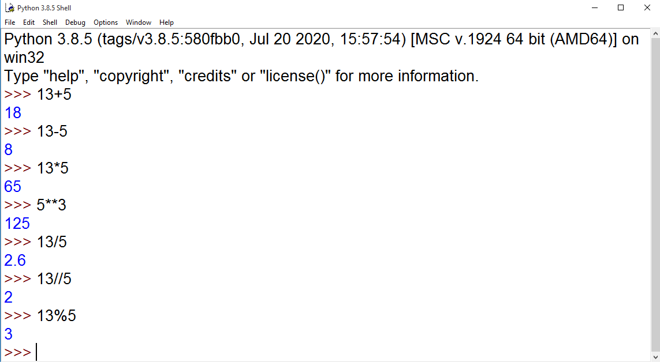
Using python interpreter as calculator

Slide 7
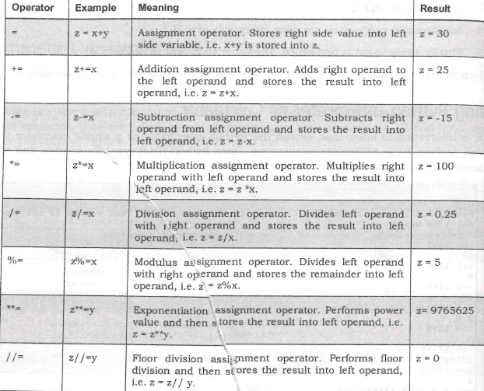
Assignment operators
These operators are useful to store the right side value into a left side variable.
Here, let us assume
the values of
x=20, y=10
and z=5

Slide 8
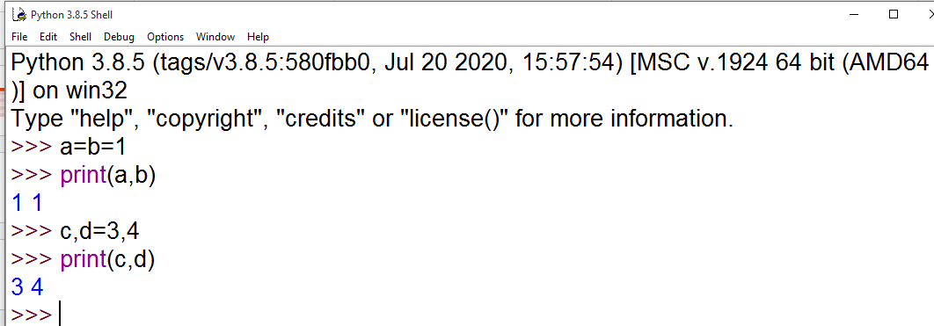
In python the following is also possible
Python does not have increment operator (++) and decrement operator (--)

Slide 9
Unary minus operator
When this operator is used before a variable, then its value is negative
Example: n=-10
print(n) #displays -10
>>> n=10
>>> print(-n)
-10
>>> num=-10
>>> num=-num
>>> print(num)
10

Slide 10
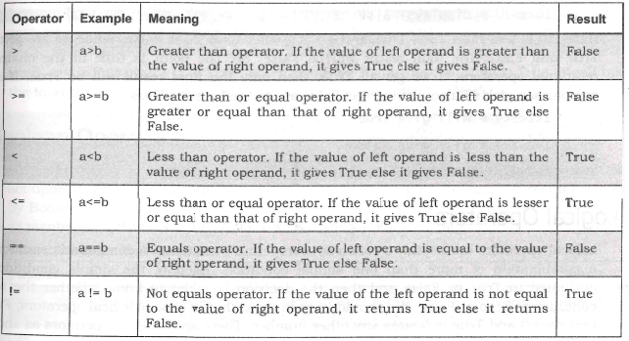
Relational operators
These operators are used to compared two elements

Slide 11
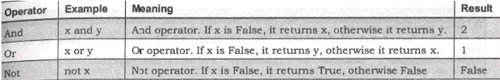
Logical operators
Useful to construct compound conditions
A compound condition of more than one simple condition, each condition is evaluated either True or False
Here suppose x=1 and y=2
Go to Jupyter notebook for examples

Slide 12
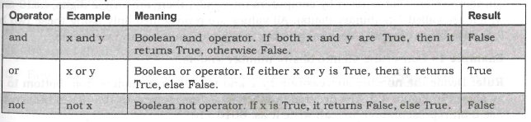
Boolean operators
Let us take x=True and y=False

Slide 13
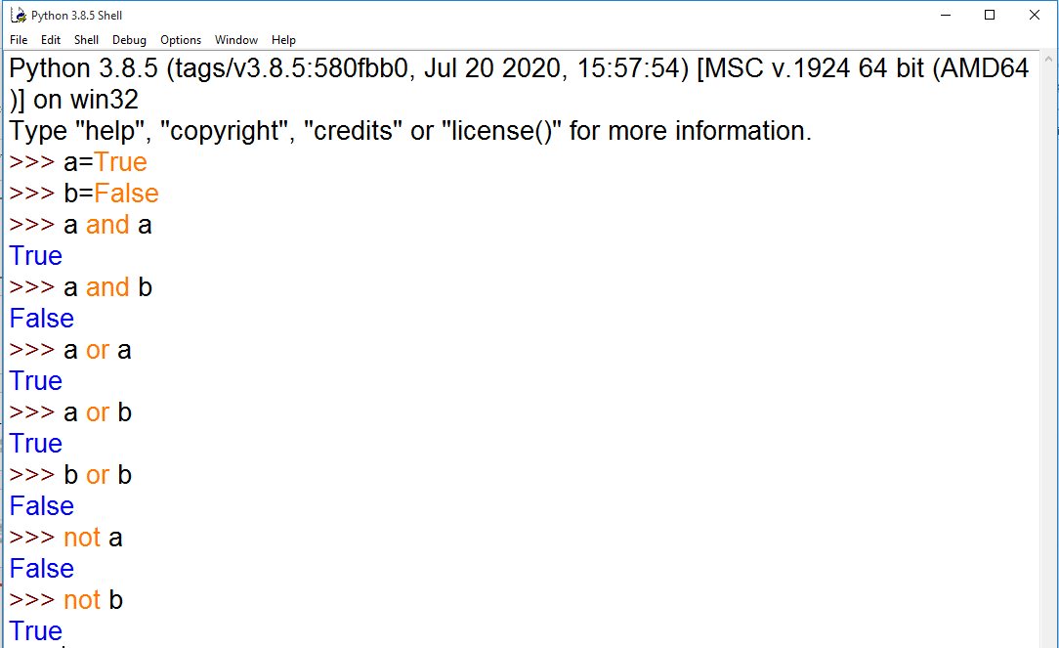

Slide 14
Bitwise operators
These operators act on individual bits (0 and 1) of the operands.
We can use these operators directly on binary numbers or on integers also.
There are 6 types of bitwise operators
Bitwise complement (~)
Bitwise AND (&)
Bitwise OR (|)
Bitwise XOR (^)
Bitwise left shift (<<)
Bitwise right shift (>>)

Slide 15
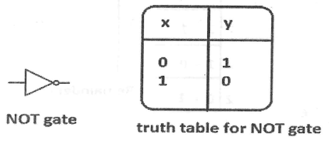
Bitwise complement (~):
This operator gives complement of a given number
>>> x=10
>>> bin(x)
'0b1010'
>>> x=~x
>>> bin(x)
'-0b1011'

Slide 16
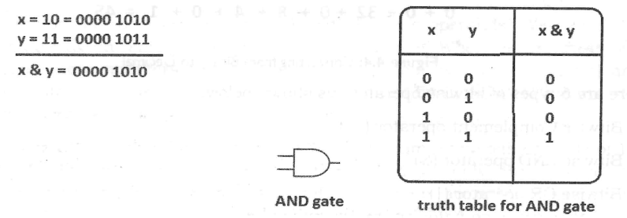
Bitwise AND (&):
It performs AND operation on individual bits of numbers

Slide 17
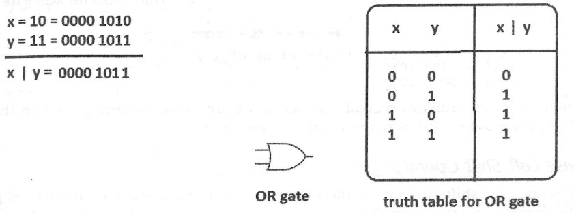
Bitwise OR (|):
It performs OR operation on individual bits of numbers

Slide 18
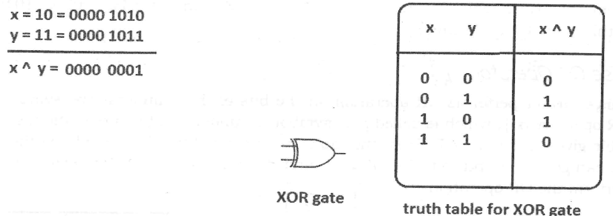
Bitwise XOR (^):
It performs XOR operation on individual bits of numbers

Slide 19
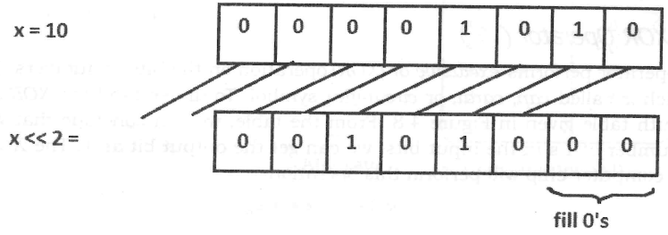
Bitwise left shift (<<):
This operator shifts the bits of the number towards left a specified number of positions
Double less then symbol

Slide 20
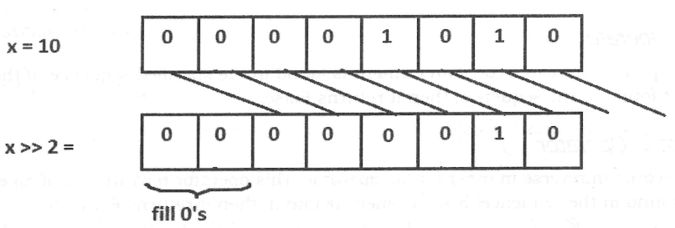
Bitwise right shift (>>):
This operator shifts the bits of the number towards right a specified number of positions
Double grater then symbol

Slide 21
Membership operators
These operators are useful to test for membership in a sequence such as strings, lists, tuples or dictionaries.
There are 2 membership operators
in : It returns True if the element is found in the sequence or otherwise it returns False
not in : It works in reverse manner for ‘in’ operator
>>> names=['ramu','mmvc','luckey','mokshitha']
>>> 'ramu' in names
True
>>> 'ramu' not in names
False
>>> 'shyam' in names
False
>>> 'shyam' not in names
True

Slide 22
Identity operators
These operators compare the memory locations of two objects.
Hence, it is possible to know whether the two objects are same or not
There are 2 identity operators
is : It returns True if identity numbers of two objects are same otherwise it returns False
is not: It works quite opposite to ‘is’ operator
>>> a=25
>>> b=23
>>> a is b
False
>>> b=25
>>> a is b
True
>>> a is not b
False

Slide 23
In order to compare the values of the objects, we should use equality operator (==)
>>> one=[1,2,3,4]
>>> two=[1,2,3,4]
>>> id(one)
819778664896
>>> id(two)
819601541312
>>> one==two
True
>>> one is two
False

Slide 24
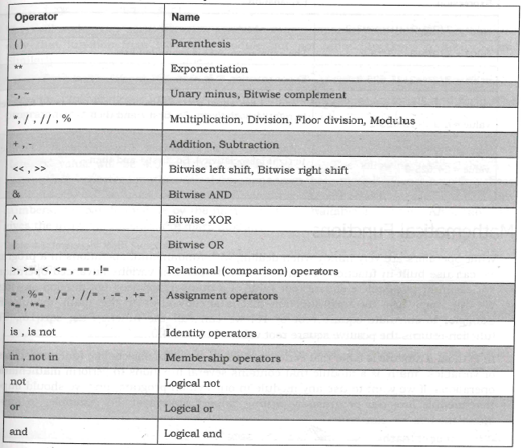
Operator precedence and associativity

Slide 25
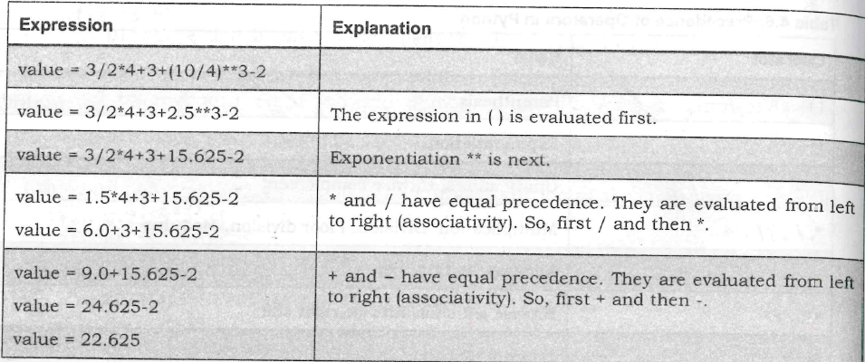
Evaluation of expression

Slide 26
Mathematical functions
Python contains a module called ‘math’ in order to do several mathematical operations
>>> import math
>>> math.sqrt(15)
3.872983346207417
>>> math.factorial(10)
3628800
>>> math.pi
3.141592653589793
>>> math.e
2.718281828459045

Slide 27
>>> import math as m
>>> m.sqrt(25)
5.0
>>> m.pi
3.141592653589793
>>> from math import factorial
>>> factorial(30)
265252859812191058636308480000000
>>> from math import sqrt,factorial
>>> sqrt(10)
3.1622776601683795
>>> factorial(5)
120

Slide 28
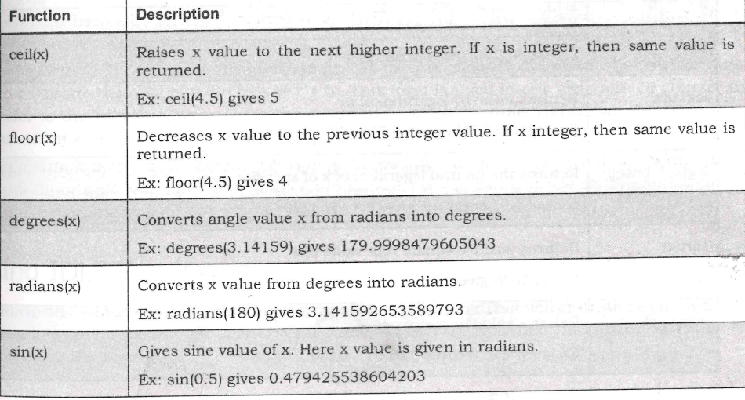

Slide 29
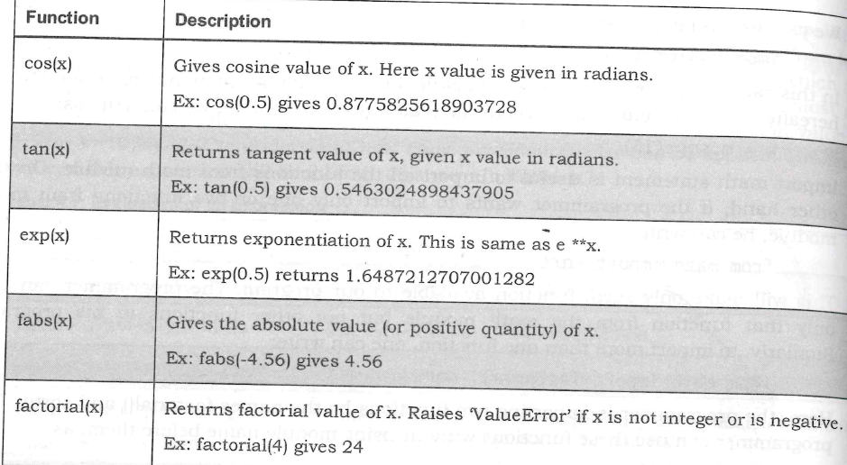

Slide 30
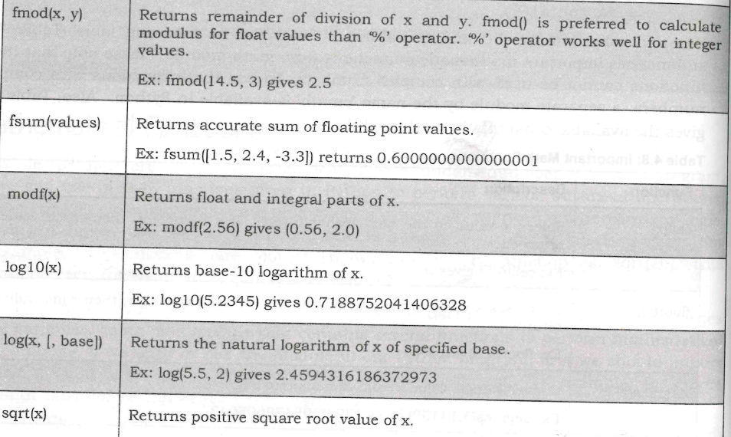

Slide 31
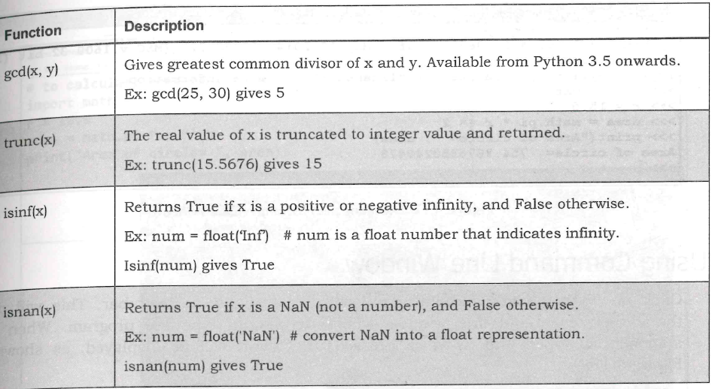

Slide 32
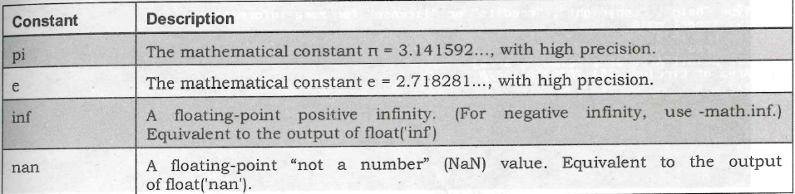
Constants in math module

Slide 33
Using IDLE Window
Using command line window
Executing at system prompt

